Slide 1
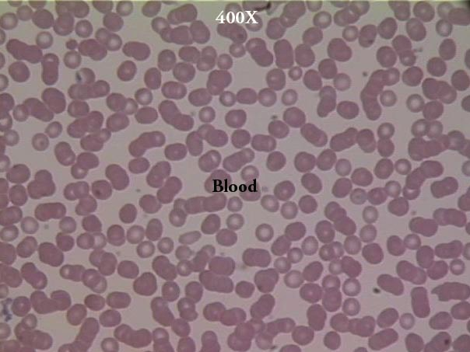
Blood?
Why All That…
Sin & Guilt Offerings in Leviticus 6:24–7:10
Dr. Rick Griffith, Crossroads International Church Singapore
BibleStudyDownloads.org

Slide 2
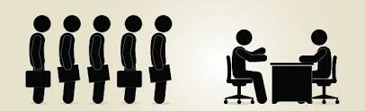
What is your biggest weakness?
Notes:
How would you answer the question about your biggest weakness in a job interview?
Esra Gurkan for MAIL ONLINE reports: “Job interviews are an unpleasant chore that we all need to go through to get the role of our dreams. It's easy enough to talk about why you want the job and why you're the best person to do it. But there is one question that everyone dreads and is most likely to trip us all up: What's your biggest weakness?
Reddit received over 1,600 comments posted on a thread, which asked for the best and the worst answers to this question. Here are a few that stood out to the question “What's Your Biggest Weakness?”:
• “I have trouble delegating tasks sometimes. I like to do things myself to ensure they're done to my personal standards, but it is something I'm working on.''
• ''I take failure a bit too hard sometimes.”
• To add some humor, someone suggested, “Remain silent, and pull an index card out of your pocket that says ‘I over-prepare.’”
• “I'm overly critical of my work.”
A few answers that are not recommended:
• "Those eyes of yours.”
• "I don't work well with people"
• “My biggest weakness is that I have too many strengths.”
• "I'm too soft spoken"
• “People say I can be condescending. That's when you talk down to people.”
One helpful suggestion was to give a skills-based weakness, something you can take steps to remedy, like:
• "I'm not too familiar with Excel at the moment, but I'm planning on taking classes this coming month.”
______
'What's your biggest weakness?' Bosses reveal how you should really answer the dreaded interview question (and the WORST responses they've ever heard)
By Esra Gurkan For Mailonline
Published: 06:47 GMT, 10 October 2016 | Updated: 20:45 GMT, 10 October 2016
Read more: http://www.dailymail.co.uk/femail/article-3825805/Job-hunters-reveal-NOT-answer-interview-question-s-biggest-weakness.html#ixzz4NAATbhNW
Accessed 15 Oct ber 2016

Slide 3

What is your biggest weakness?
Notes:
How would you answer the question about your biggest weakness in a job interview?
Esra Gurkan for MAIL ONLINE reports: “Job interviews are an unpleasant chore that we all need to go through to get the role of our dreams. It's easy enough to talk about why you want the job and why you're the best person to do it. But there is one question that everyone dreads and is most likely to trip us all up: What's your biggest weakness?
Reddit received over 1,600 comments posted on a thread, which asked for the best and the worst answers to this question. Here are a few that stood out to the question “What's Your Biggest Weakness?”:
• “I have trouble delegating tasks sometimes. I like to do things myself to ensure they're done to my personal standards, but it is something I'm working on.''
• ''I take failure a bit too hard sometimes.”
• To add some humor, someone suggested, “Remain silent, and pull an index card out of your pocket that says ‘I over-prepare.’”
• “I'm overly critical of my work.”
A few answers that are not recommended:
• "Those eyes of yours.”
• "I don't work well with people"
• “My biggest weakness is that I have too many strengths.”
• "I'm too soft spoken"
• “People say I can be condescending. That's when you talk down to people.”
One helpful suggestion was to give a skills-based weakness, something you can take steps to remedy, like:
• "I'm not too familiar with Excel at the moment, but I'm planning on taking classes this coming month.”
______
'What's your biggest weakness?' Bosses reveal how you should really answer the dreaded interview question (and the WORST responses they've ever heard)
By Esra Gurkan For Mailonline
Published: 06:47 GMT, 10 October 2016 | Updated: 20:45 GMT, 10 October 2016
Read more: http://www.dailymail.co.uk/femail/article-3825805/Job-hunters-reveal-NOT-answer-interview-question-s-biggest-weakness.html#ixzz4NAATbhNW
Accessed 15 Oct ber 2016

Slide 4

What is your biggest weakness?
Notes:
How would you answer the question about your biggest weakness in a job interview?
Esra Gurkan for MAIL ONLINE reports: “Job interviews are an unpleasant chore that we all need to go through to get the role of our dreams. It's easy enough to talk about why you want the job and why you're the best person to do it. But there is one question that everyone dreads and is most likely to trip us all up: What's your biggest weakness?
Reddit received over 1,600 comments posted on a thread, which asked for the best and the worst answers to this question. Here are a few that stood out to the question “What's Your Biggest Weakness?”:
• “I have trouble delegating tasks sometimes. I like to do things myself to ensure they're done to my personal standards, but it is something I'm working on.''
• ''I take failure a bit too hard sometimes.”
• To add some humor, someone suggested, “Remain silent, and pull an index card out of your pocket that says ‘I over-prepare.’”
• “I'm overly critical of my work.”
A few answers that are not recommended:
• "Those eyes of yours.”
• "I don't work well with people"
• “My biggest weakness is that I have too many strengths.”
• "I'm too soft spoken"
• “People say I can be condescending. That's when you talk down to people.”
One helpful suggestion was to give a skills-based weakness, something you can take steps to remedy, like:
• "I'm not too familiar with Excel at the moment, but I'm planning on taking classes this coming month.”
______
'What's your biggest weakness?' Bosses reveal how you should really answer the dreaded interview question (and the WORST responses they've ever heard)
By Esra Gurkan For Mailonline
Published: 06:47 GMT, 10 October 2016 | Updated: 20:45 GMT, 10 October 2016
Read more: http://www.dailymail.co.uk/femail/article-3825805/Job-hunters-reveal-NOT-answer-interview-question-s-biggest-weakness.html#ixzz4NAATbhNW
Accessed 15 Oct ber 2016

Slide 5

What attitude do you have about your weaknesses and sins?
Do you admit that you need forgiveness for sin?

Slide 6
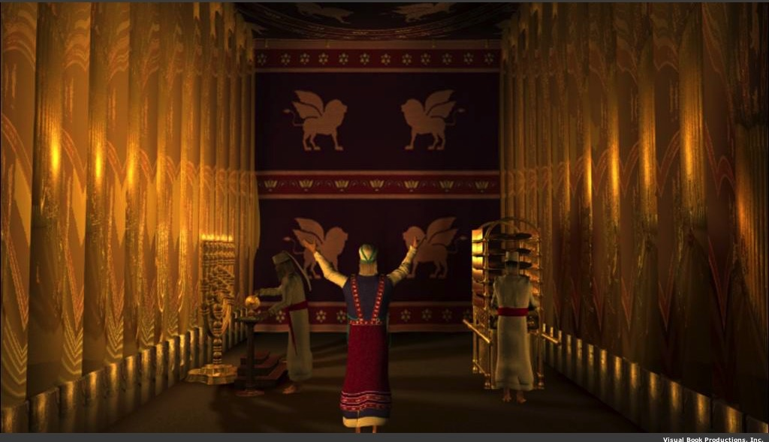
Why did God prescribe offerings for Israel's weaknesses and sins?

Slide 7

Where we're going Today…
How Israel was forgiven
How We
Are forgiven

Slide 8
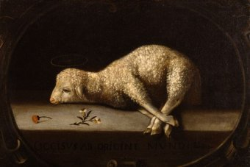
I. God forgave Israelites through the blood of offerings (Lev 4:1–5:13; 6:24-30).
Notes:
Jews restored their fellowship with the Lord through sin and guilt sacrifices.

Slide 9
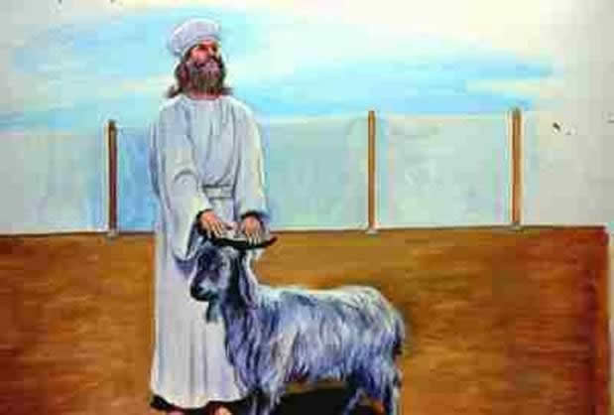
The blood of the sin offering forgave unintentional sin (4:1–5:13; 6:24-30).

Slide 10
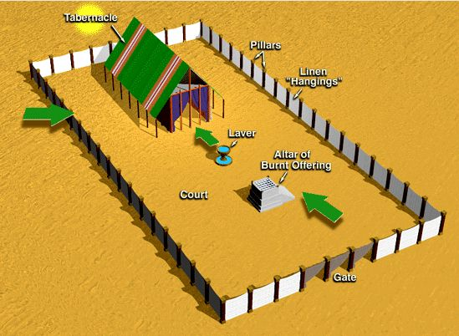
The Tabernacle & Courtyard
Tabernacle
Pillars
Linen "Hangings"
Laver
Altar of Burnt Offering
Court
Gate
Notes:
#35 in original file

Slide 11
Offering Rituals in Lev. 1–5
128
The worshipper presents his offering
He lays his hand(s) upon the victim, and possibly confesses his sin.
3. The worshipper slaughters the offering.
R. T. Beckwith, New Bible Dictionary, 1962

Slide 12
Offering Rituals in Lev. 1–5
128
4. The priest collects the blood in a basin and dashes it against the NE and SW corners of the altar in such a way that all four sides are spattered. The remainder of the blood is then poured out at the base of the altar.
R. T. Beckwith, New Bible Dictionary, 1962

Slide 13
Offering Rituals in Lev. 1–5
128
5. A portion of the sacrifice is burned.
6. Any remaining portions of the sacrifice were eaten in a sacrificial meal, either by the priests and worshippers (fellowship-offering), or by the priests and their families, or by the priests alone.
R. T. Beckwith, New Bible Dictionary, 1962

Slide 14
Offerings in Leviticus 1-7
128
Whole burnt offering 1
Grain/Drink offering 2
Fellowship offering 3
Sin offering 4:1-5:13
Guilt offering 5:14-6:7
6:8-13
6:14-23
6:24-30
7:1-10
7:11-38
People
Priests

Slide 15
Offerings in Leviticus 1-7
128
Whole burnt offering
Grain offering
Fellowship offering
Sin offering
Guilt offering
Consecration
Voluntary
Cleansing
Obligatory

Slide 16
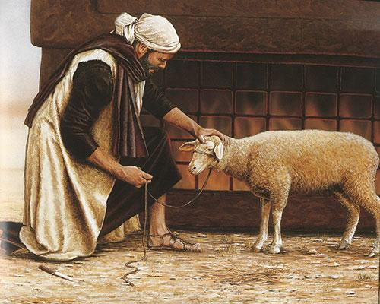
The blood and restitution of the guilt offering forgave unintentional sin
(5:14–6:7; 7:1-10).
+20%

Slide 17
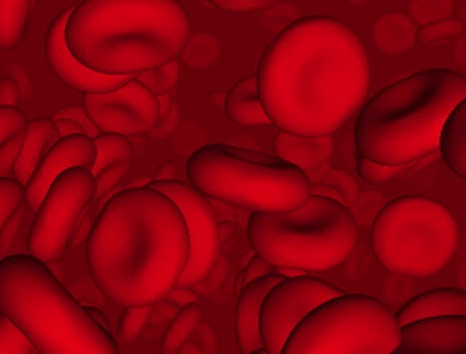
Why did God institute the sacrificial system?
Did the blood actually forgive sin?

Slide 18
Did blood sacrifices save Israelites under the Law?
BLOOD

Slide 19
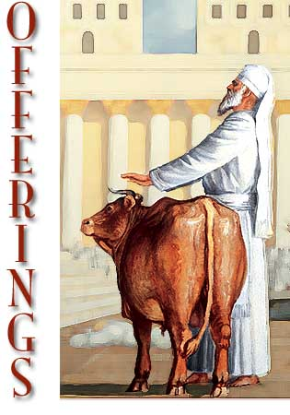
Sacrifices forgave sin
"Through this process, the priest will purify the people, making them right with the LORD, and
they will be forgiven"
(4:20 NLT; cf. 4:26, 31, 35).

Slide 20
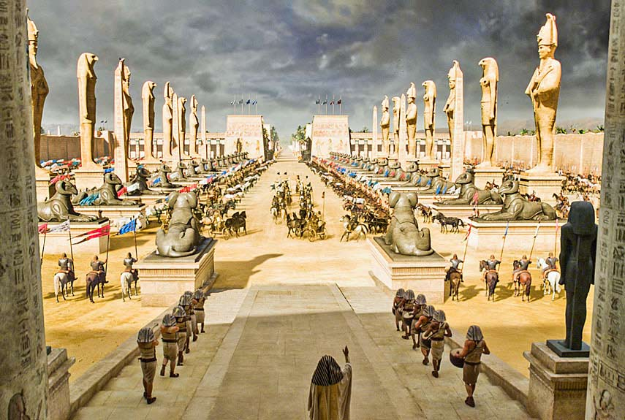
Egypt was the super power

Slide 21
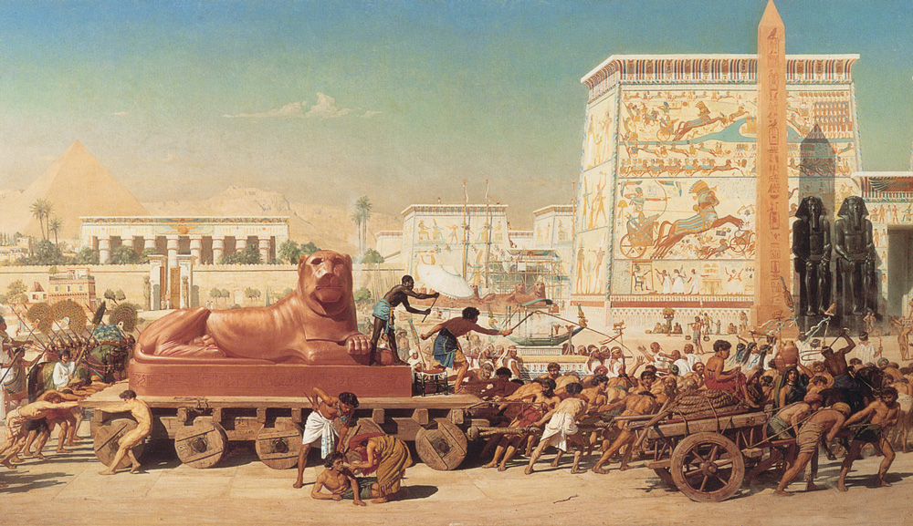
Israel was under bondage

Slide 22
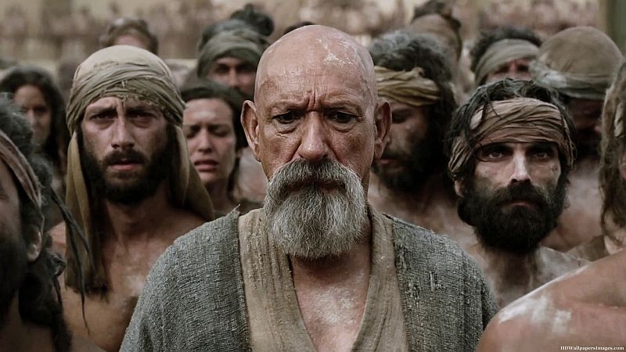
Israel was under bondage

Slide 23

Route of the Exodus
Canaan
107
Goshen
Nile River
Mt. Sinai
Egypt
Midian

Slide 24



The Passover Lamb

Slide 25

Passover Protection
"The blood will be a sign for you on the houses where you are; and when I see the blood, I will pass over you. No destructive plague will touch you when I strike Egypt."
Exodus 12:13 (NIV)

Slide 26
Faith Pictured
"By faith he kept the Passover and the sprinkling of blood, so that the destroyer of the firstborn would not touch the firstborn of Israel."
Hebrews 11:28 (NIV)

Slide 27

Faith in a Lamb

Slide 28

Exodus 12:1-16
The Angel of Death Passed Over Houses with Blood on the Doors
Thus says the LORD, "About midnight I will go out in the midst of Egypt" (Exod. 11:4)

Slide 29
Salvation & Sanctification
121a
Man's Role
God's Response
Life of Faith
Restored Fellowship
Faith in God as offered Passover Lamb
Journey to Canaan
Sacrifices
(Sin, Guilt)
OT
Exodus

Slide 30
OT Forgiveness of Sin
121b
Pipe = Relationship with God (never changing)
Sin
Clog = Fellowship with God (hindered by sin)
Sacrifices = Confession of Sin (sin forgiven to restore fellowship but relationship was never threatened)
Notes:
Do we still have a relationship with God when we sin? Yes!
Sin does not hinder our relationship with God but our fellowship with Him.
OT sacrifices did not establish a relationship with God but rather they restored their fellowship with God

Slide 31
I. God forgave Israelites through the blood of offerings (Lev 4:1–5:13; 6:24-30).

Slide 32
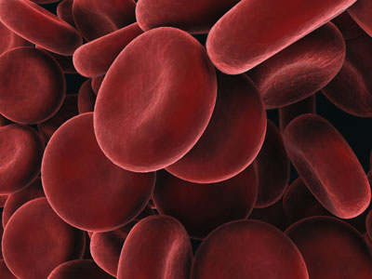
II. God forgives us though the blood of Christ
So why did God send Jesus?
Notes:
We restore our fellowship with God with Jesus' blood that saves us.

Slide 33
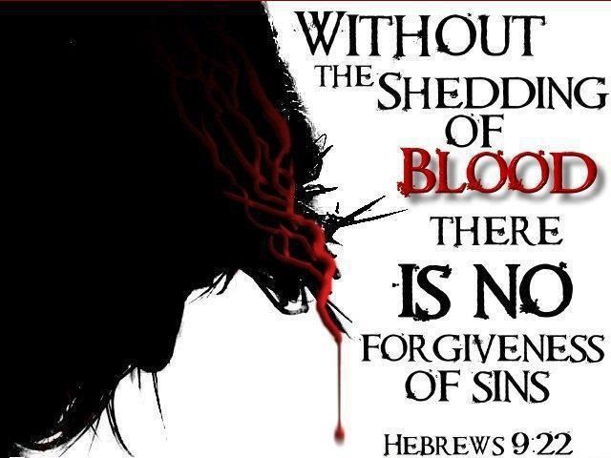
Black on White

Slide 34

Which is the Most Accurate?
121a
Salvation by…
Faith + Works
Faith Alone
Faith + Works
OT
Works
Faith Alone
Faith Alone
Faith + Works
NT
Faith
• Which verses in the Bible support your answer?
cf. OTS 119e

Slide 35
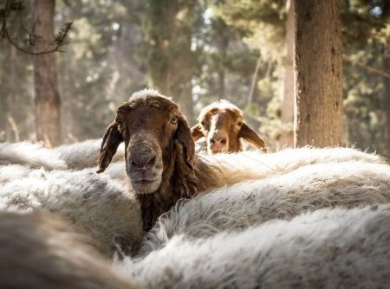
Do animals save?

Slide 36
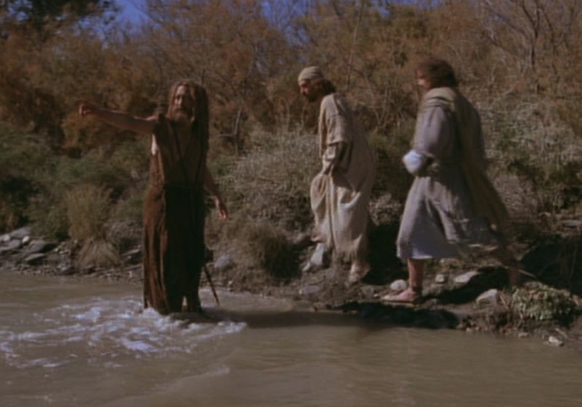
The Passover Lamb
"Look, the Lamb of God,
who takes away
the sin of the world!"
(John 1:29)

Slide 37
The Lamb Pictured
"The next day John saw Jesus coming toward him and said, 'Look, the Lamb of God, who takes away the sin of the world!'"
John 1:29 (NIV)

Slide 38
The Cross Pictured
"For Christ, our Passover lamb, has been sacrificed."
1 Corinthians 5:7 (NIV)

Slide 39
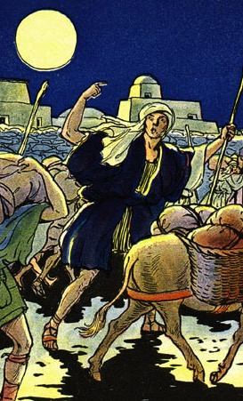
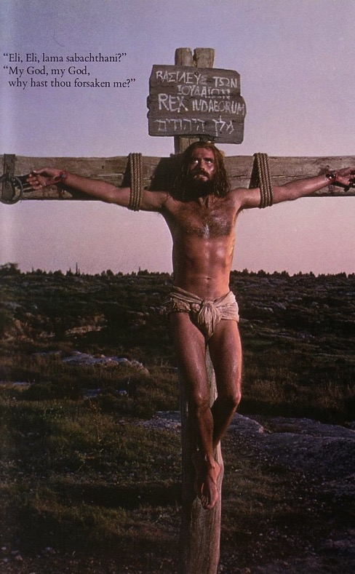
The Common Thread
What the Exodus is to the Old Testament…
the cross of Christ is to the New Testament
Deliverance!

Slide 40

"This is my body…"

Slide 41
Salvation & Sanctification
121a
Man's Role
God's Response
Life of Faith
Restored Fellowship
Faith in God as offered Passover Lamb
Journey to Canaan
Sacrifices
(Sin, Guilt)
OT
Exodus
Type
|
Antitype
Type
|
Antitype
Type
|
Antitype
Type
|
Antitype
Faith in Christ as Lamb of God (1 Cor. 5:7)
Salvation
(1 Cor. 10:1-4)
Growth
(1 Cor. 10:5)
Confession
(1 John 1:9)
NT
Positional Sanctification
Progressive Sanctification

Slide 42
NT Forgiveness of Sin
121b
"If we confess our sins,
He is faithful and righteous to forgive us our sins and to cleanse us from all unrighteousness"
(1 John 1:9 NAU)
Pipe = Relationship with God (never changing)
Sin
Clog = Fellowship with God (hindered by sin)
Christ's Sacrifice = The Basis for Confession of Sin (sin forgiven to restore fellowship but relationship was never threatened)
Notes:
Do we still have a relationship with God when we sin? Yes!
Sin does not hinder our relationship with God but our fellowship with Him.
OT sacrifices did not establish a relationship with God but rather they restored their fellowship with God

Slide 43
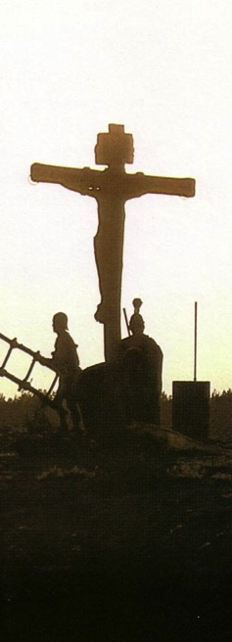
Salvation in All Ages:
The Centrality of the Cross
B.C.
Looked forward to the Cross of Christ
A.D.
Look back at the Cross of Christ

Slide 44
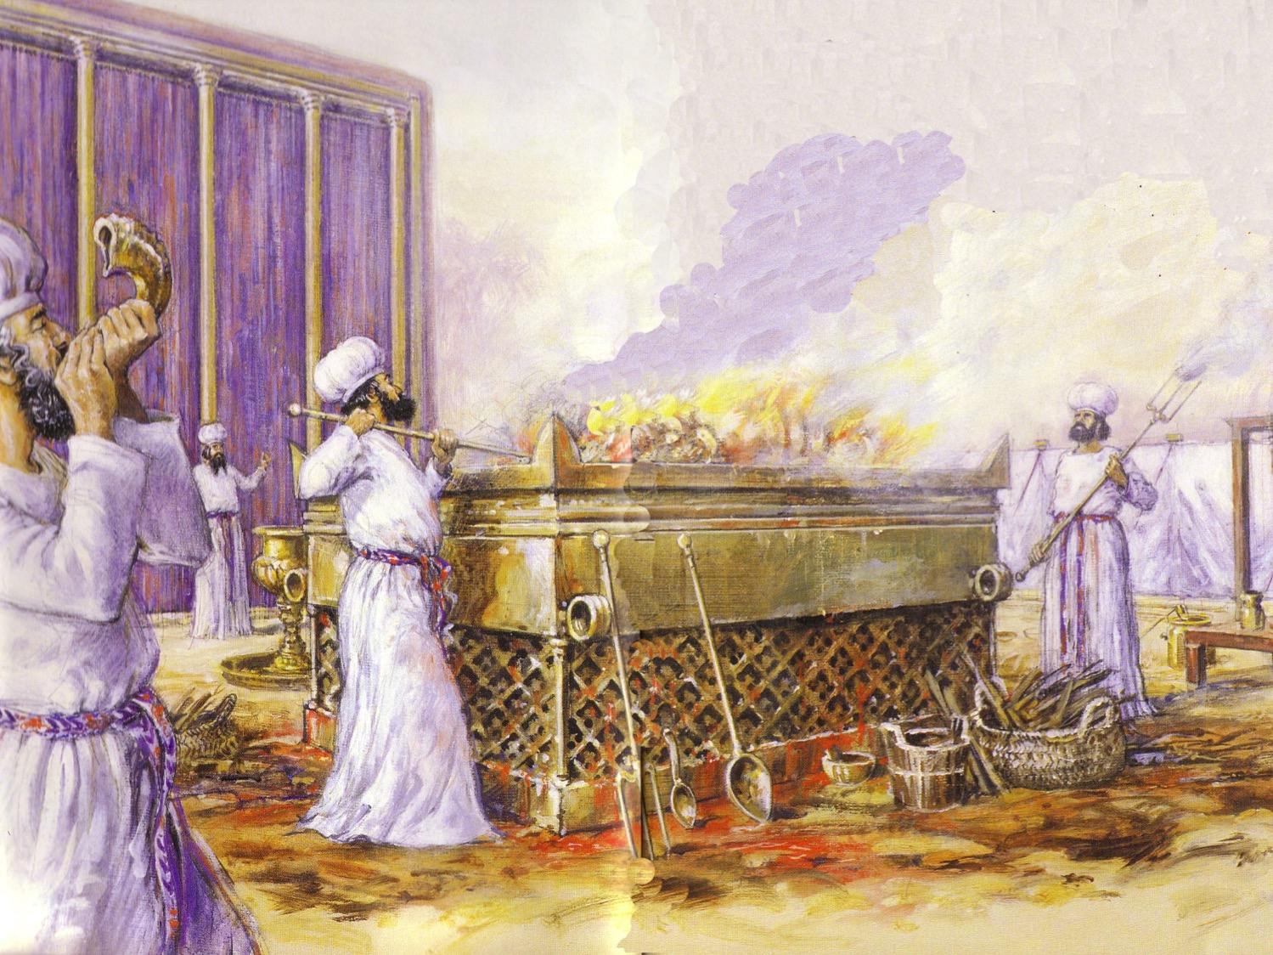
Leviticus Synthesis
124
Sanctification through sacrifice and separation
1–10 Sacrifice
(worshipping God)
11–27 Separation
(walking with God)

Slide 45
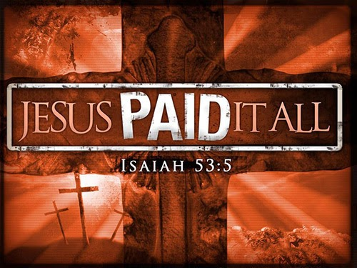
Main Idea
JESUS PAID IT ALL
Jesus is our sin offering.

Slide 46
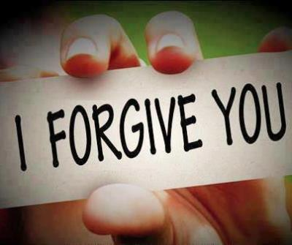
How can Christ's blood forgive our sins?

Slide 47
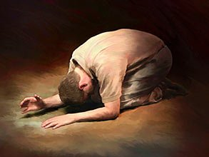
Christ's blood forgives in two ways:
Trusting in Christ's blood puts unbelievers in a relationship with God
—Confess Jesus as Saviour—
Confessing our sins restores the
believers in their fellowship with God
—Confess Jesus as Lord—

Slide 49


OT Sermons link at BibleStudyDownloads.org
Get this presentation for free!
Notes:
OT Survey (os)

